Slide 1
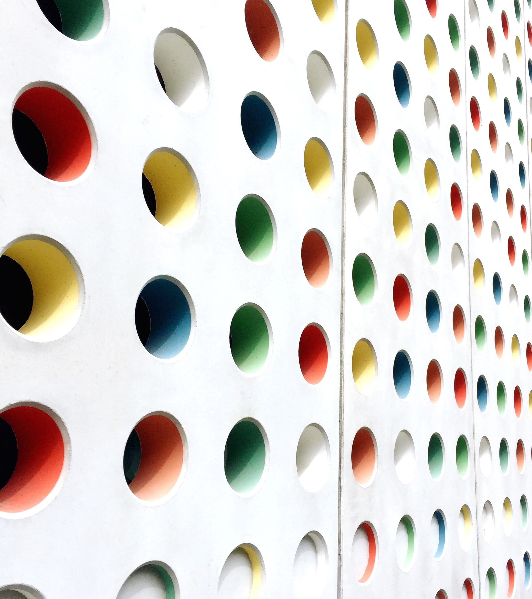
Creating a Just, Learning Culture.
Andrew Stiles
CSD-380
Assignment 9-1

Slide 2

Agenda
Introduction to Just Culture
Common Barriers and Challenges
Organizational and Cultural Resistance
Leadership and Communication Gaps
Lessons Learned and Conclusion
Sources

Slide 3

Introduction to Just Culture
A Just Culture promotes accountability, transparency, and learning from mistakes instead of punishing them. It focuses on understanding why errors happen rather than assigning blame. However, building this kind of culture isn’t easy.
Organizations often face resistance, fear, and structural barriers that prevent open communication and continuous learning.

Slide 4

Organizational Barriers
Fear of punishment discourages employees from reporting errors
Lack of psychological safety limits honest discussion about mistakes
Rigid hierarchies make it difficult for staff to question decisions or raise concerns
Inconsistent application of policies leads to mistrust and confusion

Slide 5

Leadership and Communication Challenges
Leaders may fail to model transparency or admit their own mistakes
Poor communication prevents lessons learned from reaching all teams
Limited feedback loops slow down improvement
Overemphasis on performance metrics can overshadow learning and fairness

Slide 6
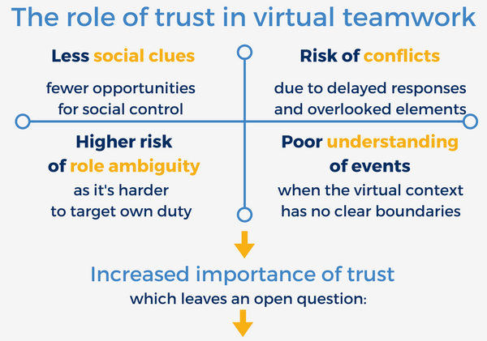
Trust -> Communication -> Learning -> Improvement
This Photo by Unknown Author is licensed under CC BY-NC-ND
This Photo by Unknown Author is licensed under CC BY-NC-ND

Slide 7

Lessons Learned and Conclusion
Building a Just Culture takes time, leadership commitment, and trust. I believe organizations succeed when they replace fear with curiosity and accountability with understanding. The real challenge is consistency, turning the idea of fairness into daily practice. When people feel safe to speak up, they learn faster, collaborate better, and strengthen the organization as a whole.

Slide 8

References
Ingram, C. (2023, July 25). Breaking down barriers to realising a just culture. LinkedIn. https://www.linkedin.com/pulse/breaking-down-barriers-realising-just-culture-chris-ingram/
Gaur, P. S., & Keshri, R. (2023). Building a just culture in healthcare organizations: Challenges and solutions. Indian Journal of Psychiatry, 65(Suppl 2), S199–S205. https://pmc.ncbi.nlm.nih.gov/articles/PMC10186448/

